Slide 1
Angular 2 and TypeScript with ASP.Net Core
Getting Started
Presented By - S. M. Abrar Jahin

Slide 2
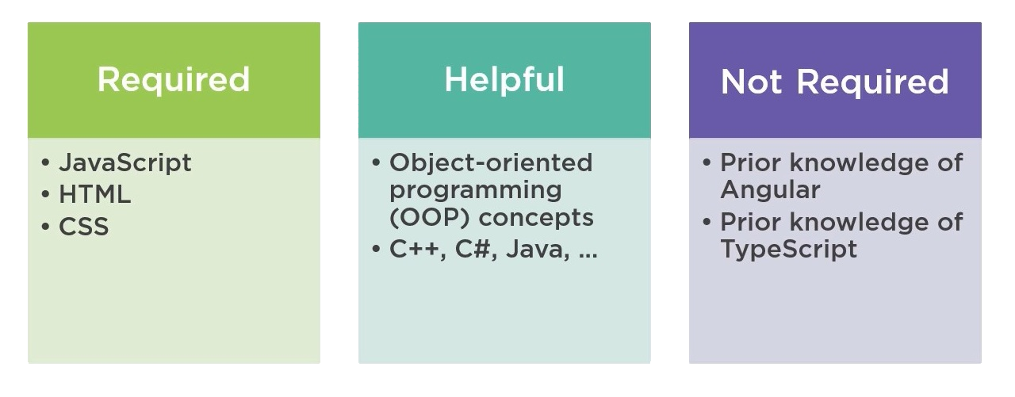
Prerequisite

Slide 3

What will we learn from here?
Why Angular 2?
Notes:
We know jQuery, AngularJS, ReactJS, then why we need to learn angular2 anyway?

Slide 4
How will we learn from here?
Step 1 Learn Basics
Step 2 Learning Work Flow
Step 4 Set up a new Angular 2 Project with ASP.Net Core
Step 5 Create a new Project with ASP.Net Core and Angular 2
Step 3 Wrapping Things Up

Slide 5
What will we learn from here?
What is Angular 2
Why we need TypeScript
Why Angular2 is different
Angular2
Components
Meta Data
Binding
Pipes
Triggering DOM Events
Lifecycle Hooks
Services
Http and Observables
Navigation and Routing
Bootstrapping in 1 place
Wrapping everything up with Dot.Net Core
Create a demo CRUD app with Angular 2 and Dot.Net Core

Slide 6
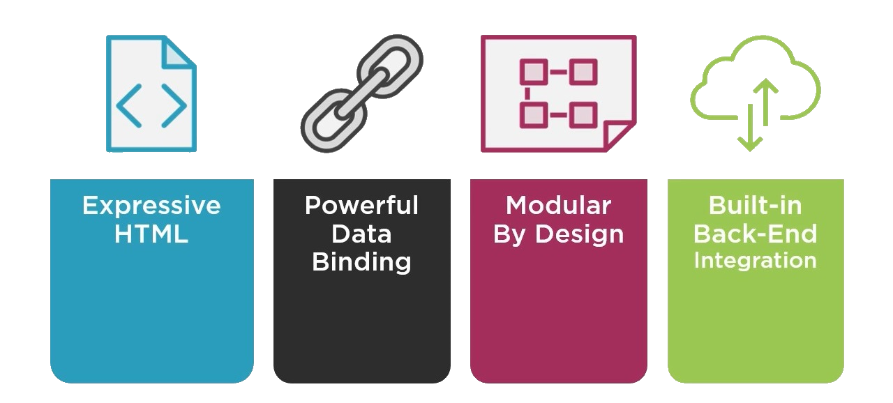
Why Angular?

Slide 7
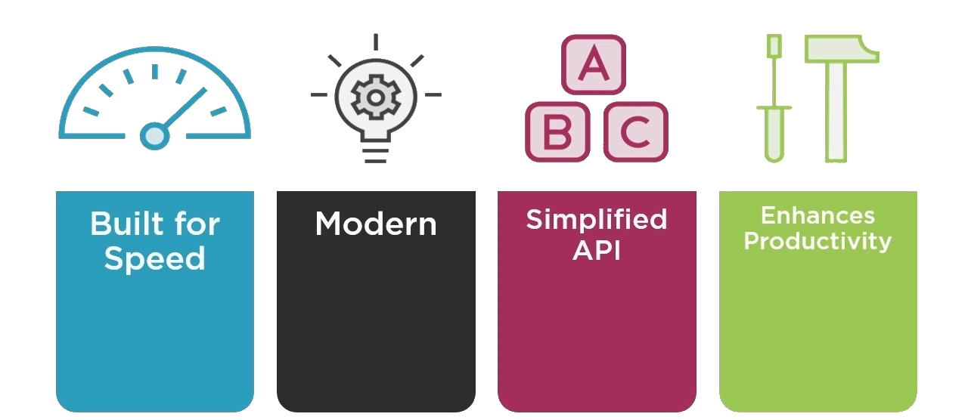
Why Angular 2?
Notes:
Super Fast, faster than AngularJS
Complete Template Engine, no need to use server based template engine
SEO Friendly URL
Easy to learn, if you are used to code in MVC

Slide 8
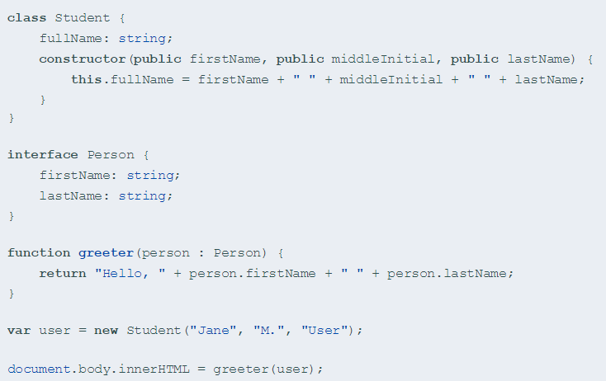
What is TypeScript
More - https://www.typescriptlang.org/docs/tutorial.html

Slide 9
Why we need TypeScript?

Slide 10
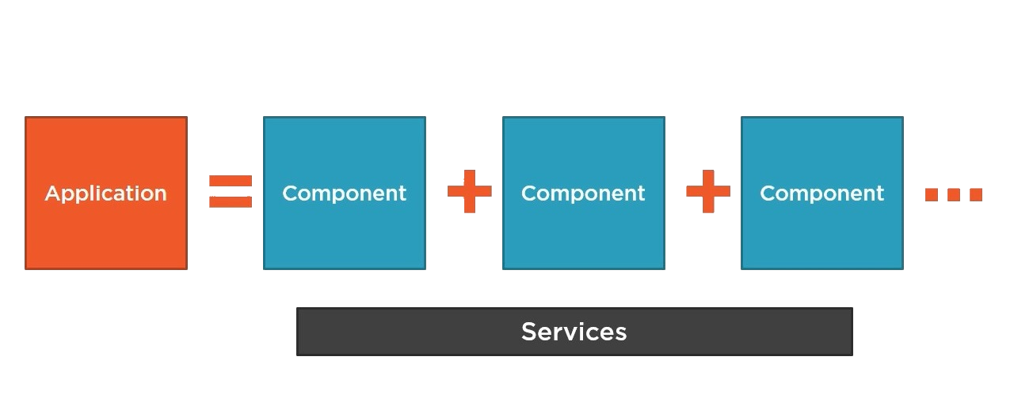
Building Block of an Angular 2 App

Slide 11
Components

Slide 12
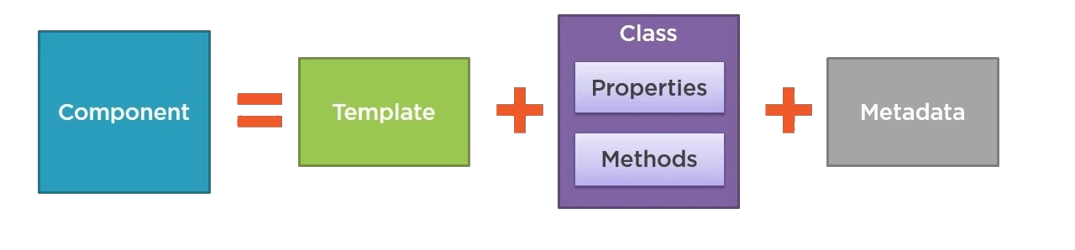
What is Component

Slide 13
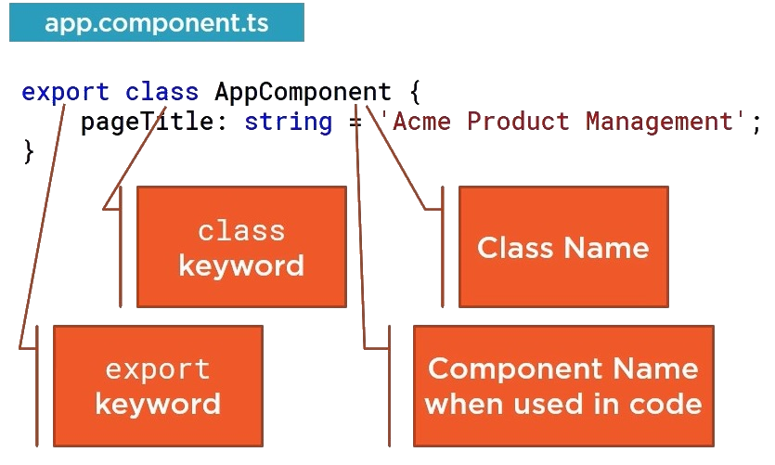
Creating a component Class

Slide 14
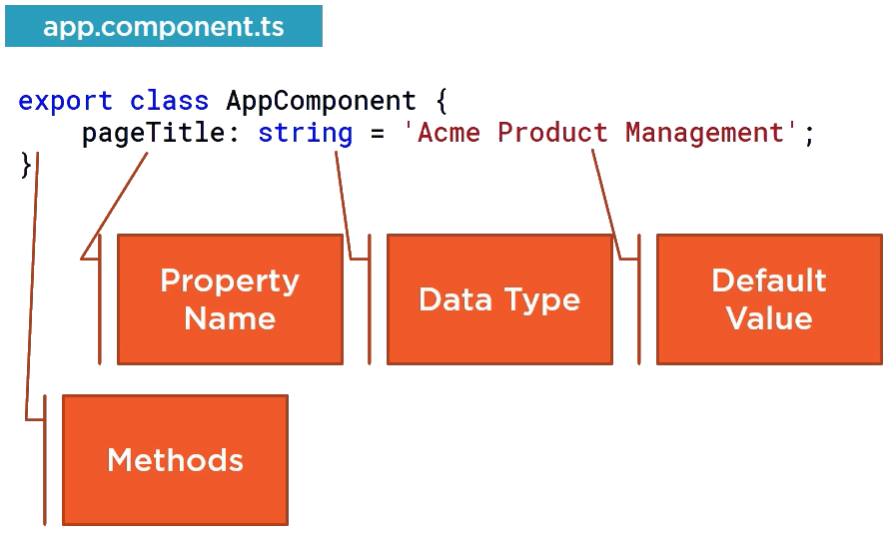
Creating a component Class : Cont.

Slide 15
Meta Data

Slide 16
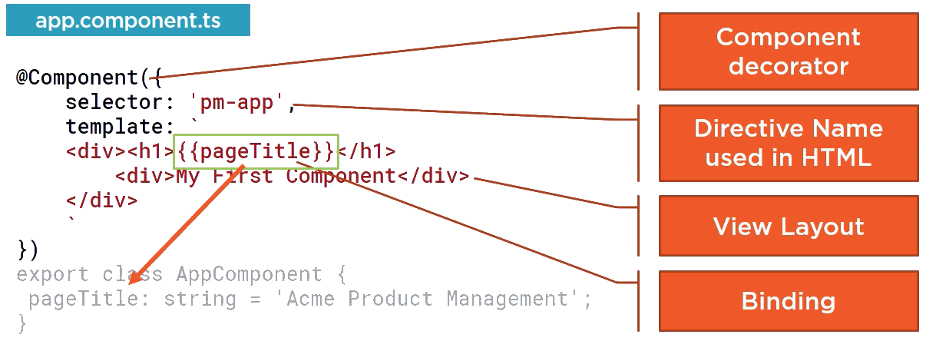
Defining Meta Data

Slide 17
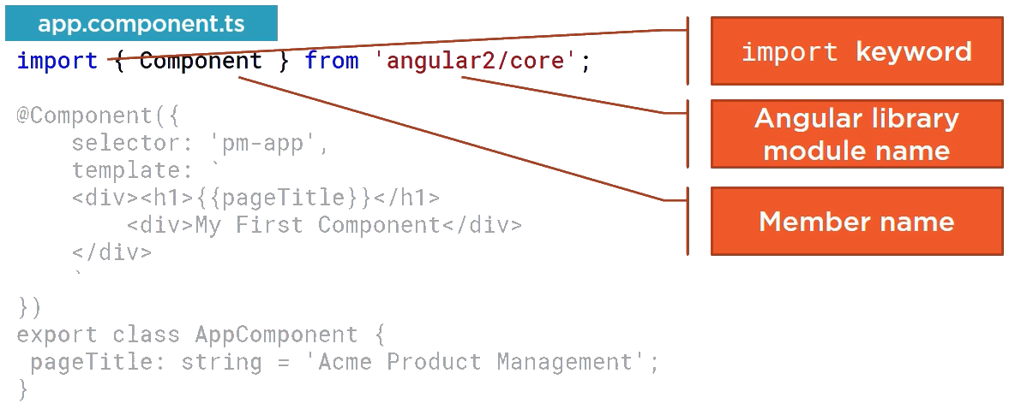
Importing

Slide 18
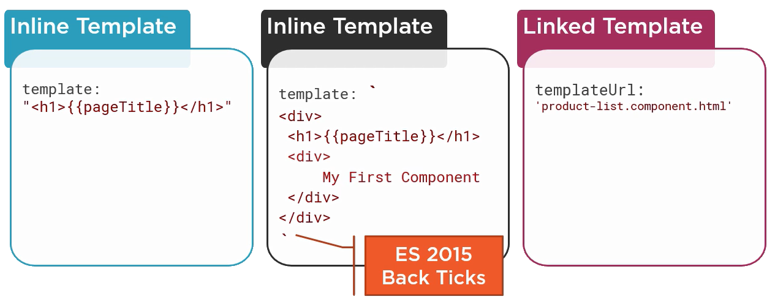
Templating
templateUrl: ‘location_of_the_template’
template : require(‘location_of_the_template’)

Slide 19
Bootstrapping

Slide 20
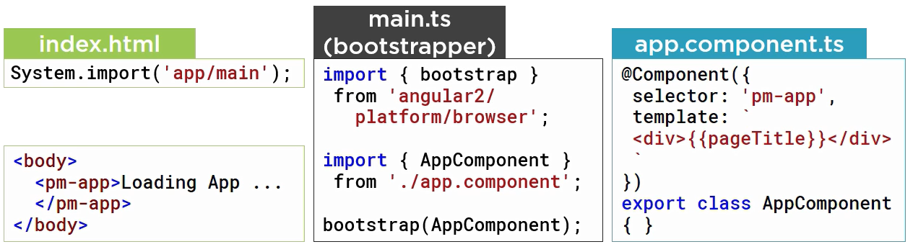
Bootstrapping

Slide 21
Nested Components
Using one component in another component

Slide 22
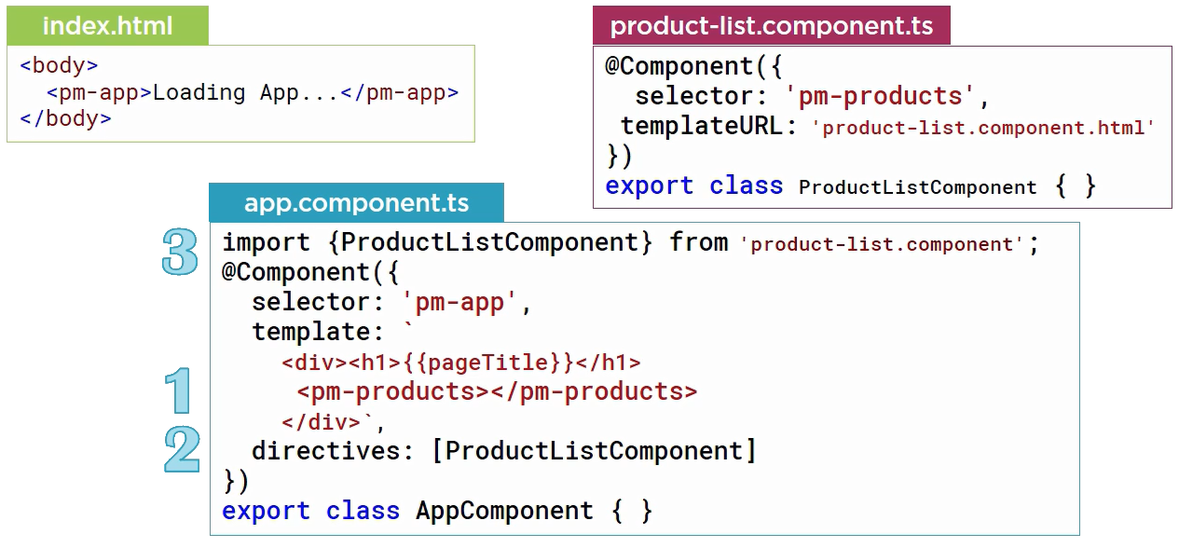
Component as a Directive

Slide 23
Binding

Slide 24
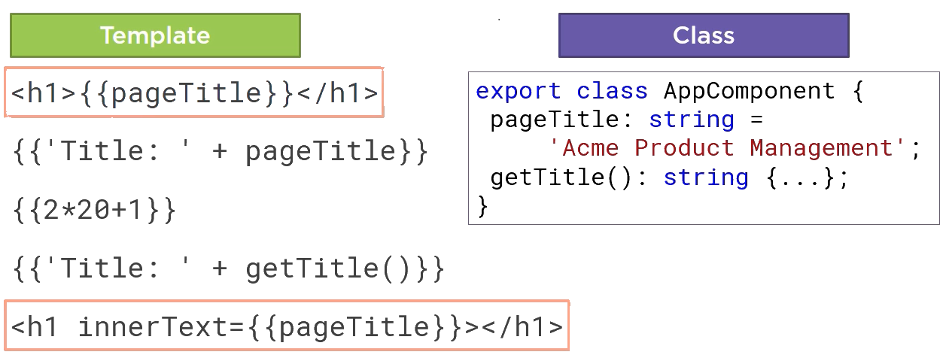
Data Binding with Interpolation

Slide 25
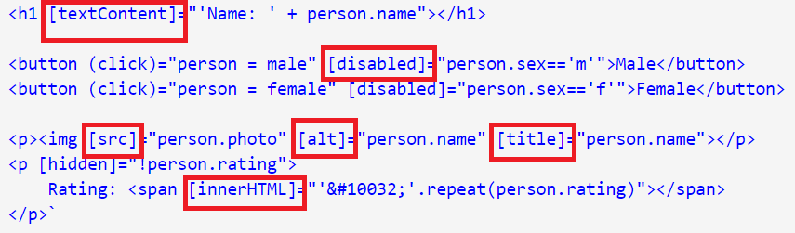
Property Binding

Slide 26
Data Filtering

Slide 27
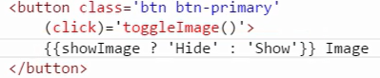
With Expression

Slide 28
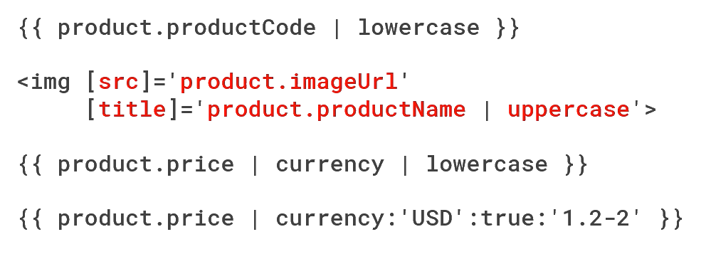
With Pipes
List of Build In Pipes-
https://www.cheatography.com/nathane2005/cheat-sheets/angular2-pipes/
We can also create custom pipes.

Slide 29
Events

Slide 30
Dom Events
All DOM Event List - http://www.w3schools.com/jsref/dom_obj_event.asp

Slide 31
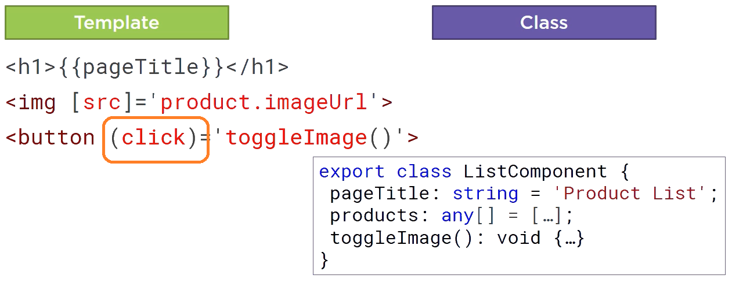
Triggering DOM Events with Event Binding

Slide 32
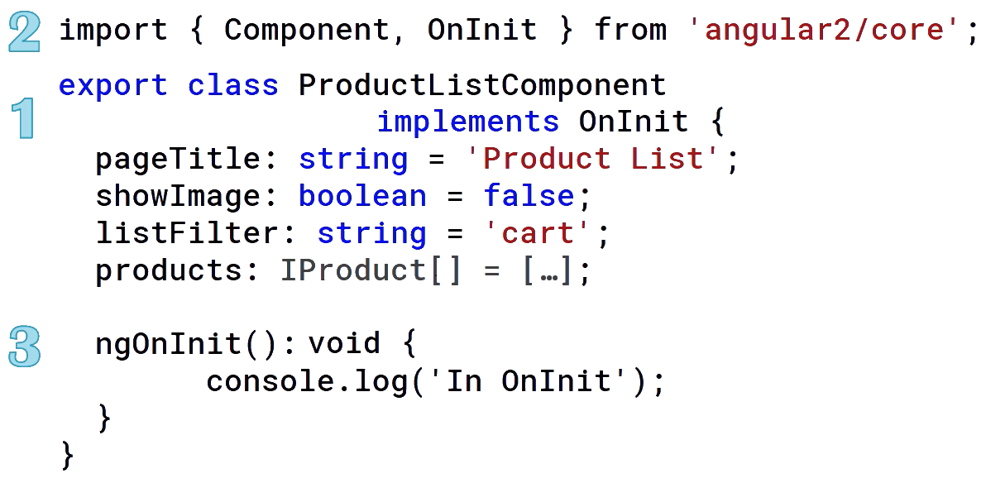
Lifecycle Hooks
List Of Lifecycle Events- http://myrighttocode.org/blog/typescript/angular2/angular-2-lifecycle

Slide 33
Using HTTP

Slide 34
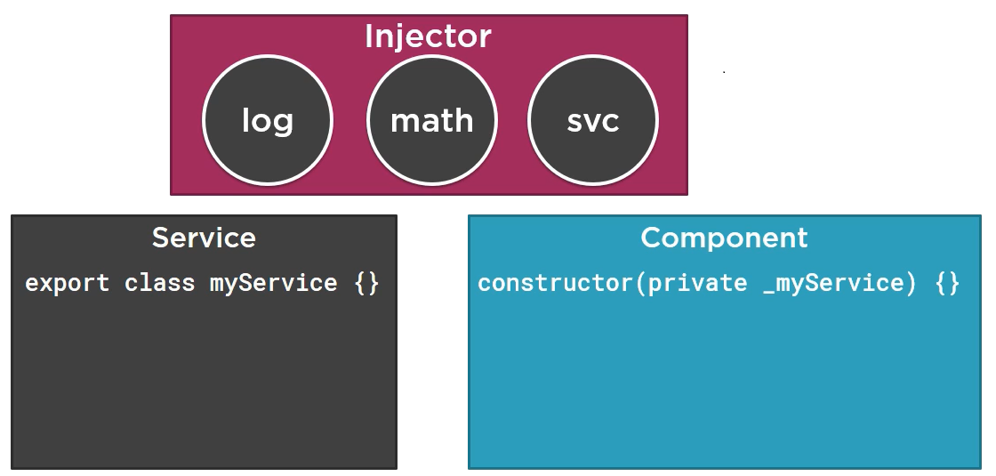
Dependency Injection

Slide 35
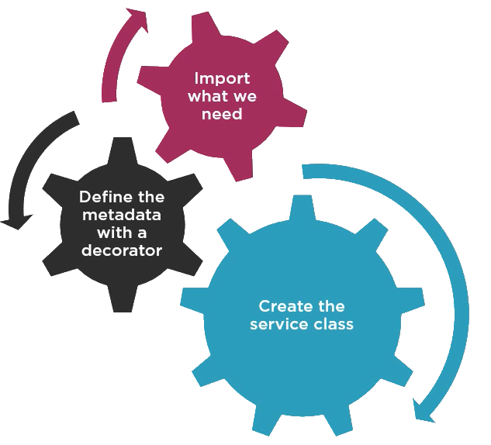
Service – Process of Working

Slide 36
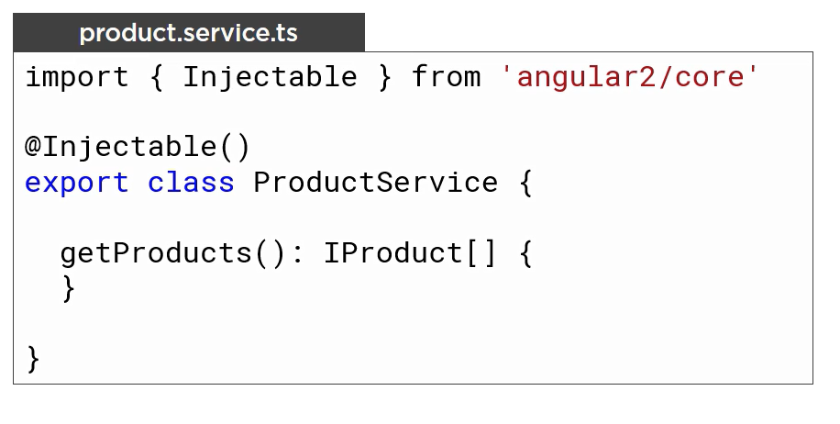
Creating a Service

Slide 37
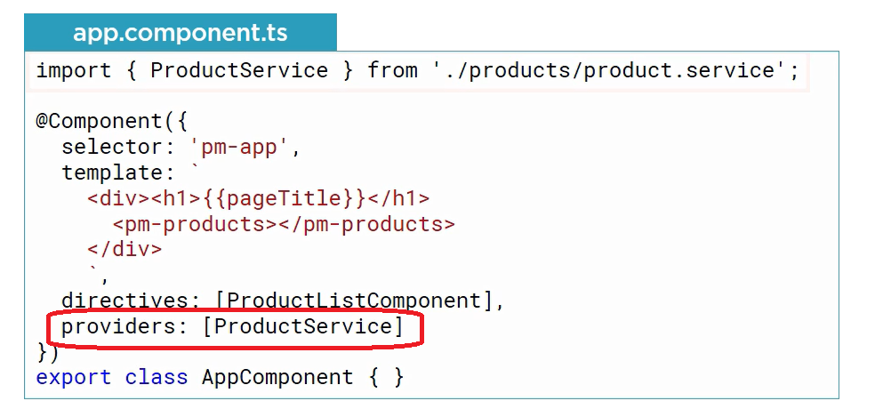
Registering a Service

Slide 38
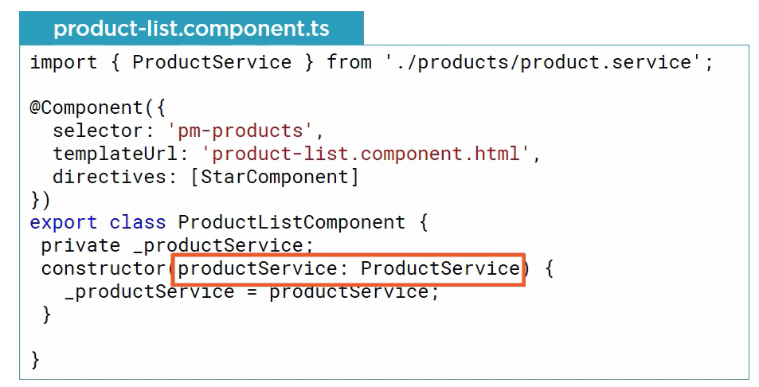
Inject a Service to Use

Slide 39
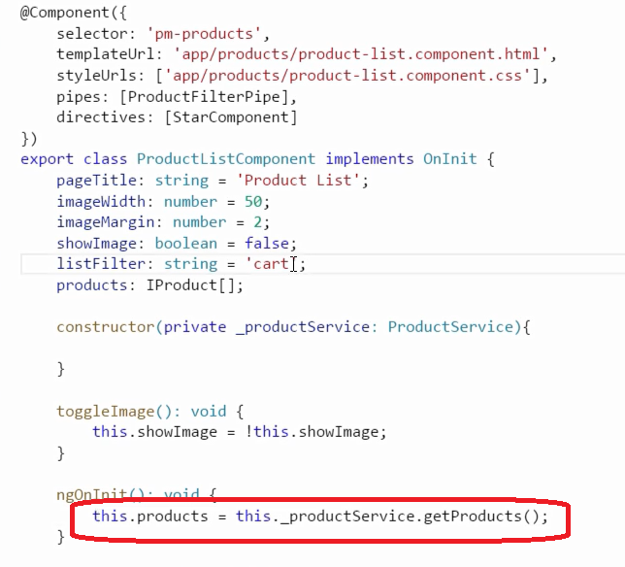
Calling a Service Method

Slide 40
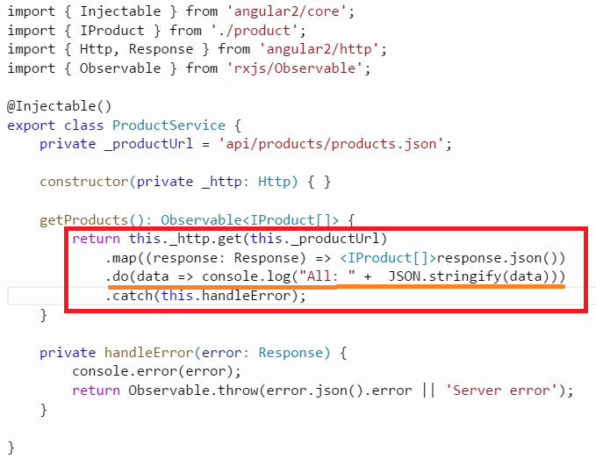
Creating a HTTP Request
More can be found - https://coursetro.com/posts/code/20/Angular-2-Services-Tutorial---Understanding-&-Creating-Them

Slide 41
Routing

Slide 42
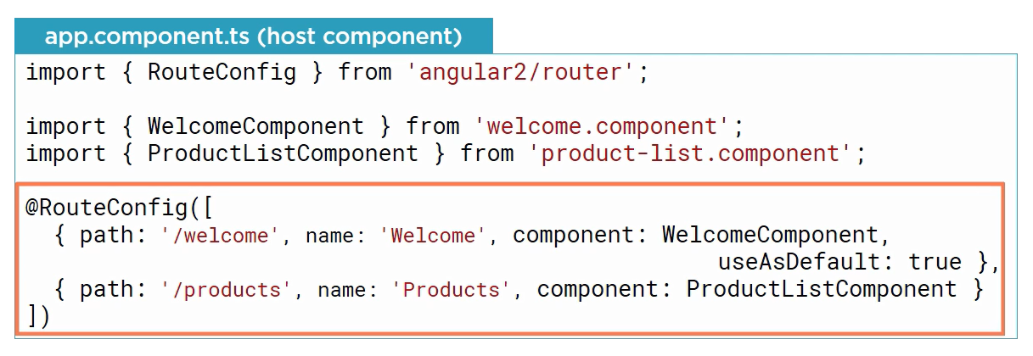
Configuring Routes

Slide 43
What we can do from here?
Documentation - http://devdocs.io/angular~2_typescript/
Create a new App with Angular 2

Slide 44


All contents - https://github.com/abrarjahin/Dot.NetCore_Angular2_App

